Slide 1
Pandas in Python

Slide 2
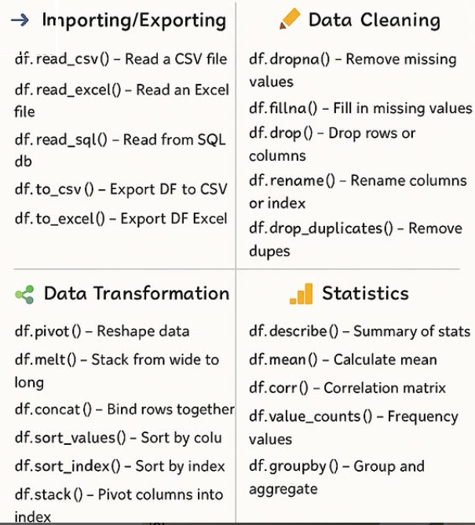
Pandas Essentials

Slide 3
Pandas Introduction
Pandas is a newer package built on top of NumPy, and provides an efficient implementation of a DataFrame.
DataFrames are essentially multidimensional arrays with attached row and column labels, and often with heterogeneous types and/or missing data.
Pandas implements a number of powerful data operations familiar to users of both database frameworks and spreadsheet programs.
Pandas, and in particular its Series and DataFrame objects, builds on the NumPy array structure and provides efficient access to these sorts of “data manuplating” tasks that occupy much of a data scientist’s time.

Slide 4
Difference Between Pandas Series and DataFrame
Feature | Series | DataFrame
Definition | 1-dimensional labeled array (like a single column in Excel). | 2-dimensional labeled data structure (like a whole Excel table).
Shape | 1D → (n,) | 2D → (rows, columns)
Data Type | Can hold only one data type (all elements must be same type, e.g., all int/float/str). | Can hold multiple data types across columns (int, float, str, etc.).
Indexing | Has a single index (row labels). | Has both row index and column index.
Creation | pd.Series([10,20,30]) | pd.DataFrame({"A":[10,20], "B":[30,40]})
Use Case | Represents a single column or 1D array. | Represents a full dataset (table).

Slide 5
1. Creating Data
pd.Series() – Create a Series (1D labeled array).
pd.DataFrame() – Create a DataFrame (2D table).
pd.read_csv() – Load data from CSV file.
pd.read_excel() – Load data from Excel file.
pd.read_sql() – Load data from SQL database.
pd.read_json() – Load data from JSON.
pd.read_html() – Read tables from HTML.
pd.read_parquet() – Load data from Parquet file.

Slide 6
#Check the version:
import pandas
pandas.__version__
We will import Pandas under the alias pd
import pandas as pd

Slide 7

The Pandas Series Object
A Pandas Series is a one-dimensional array of indexed data.
It can be created from a list or array as follows:
1D array like structure with axis labels
Ex: collection of integers: 12, 23, 34…
Data :
Index :
12 | 23 | 34 | 15 | 65 | 45 | 77 | 24 | 66 | 33
0 | 1 | 2 | 3 | 4 | 5 | 6 | 7 | 8 | 9

Slide 8
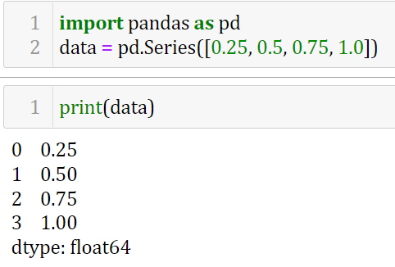
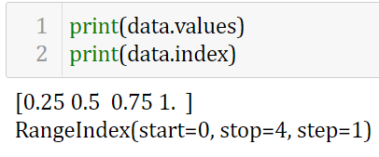

Slide 9
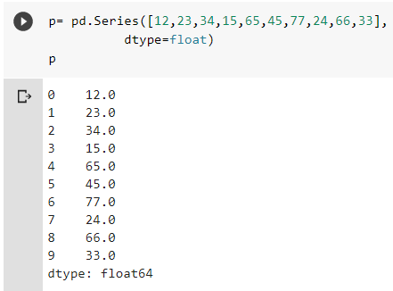
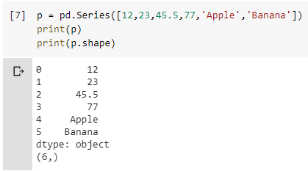

Slide 10
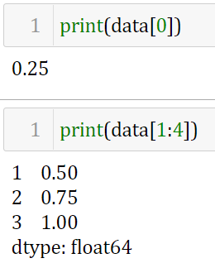
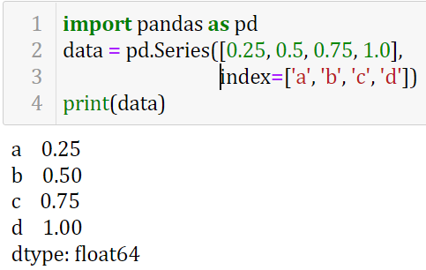
Accessing data
While the NumPy array has an implicitly defined integer index used to access the values, the Pandas Series has an explicitly defined index associated with the values.

Slide 11
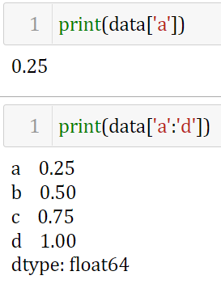
Accessing data
While the NumPy array has an implicitly defined integer index used to access the values, the Pandas Series has an explicitly defined index (reindexing) associated with the values.

Slide 12
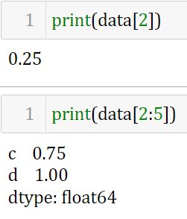
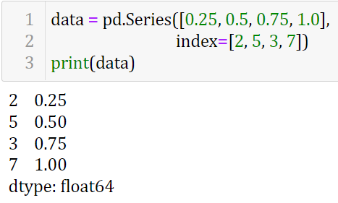
Accessing data
We can even use non-contiguous or non-sequential indices

Slide 13
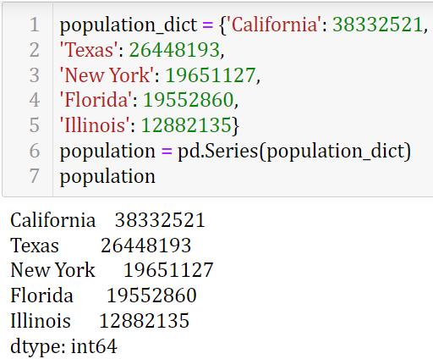
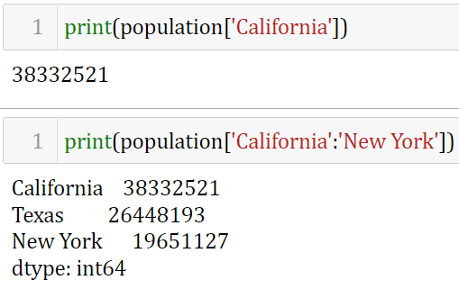
Series as specialized dictionary
Series will be created where the index is drawn from the keys.
The Series also supports array-style operations such as slicing

Slide 14
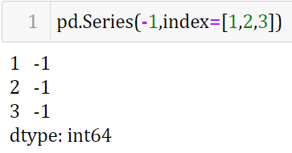
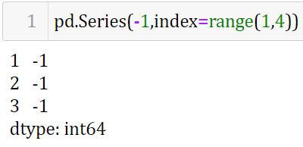
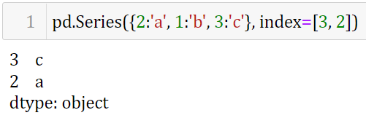
Data can be a scalar, which is repeated to fill the specified index:
The Series is populated only with the explicitly identified keys

Slide 15
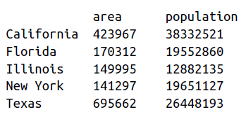
The Pandas DataFrame Object
you can think of a DataFrame as a sequence of aligned Series objects
2D tabular like structure
Heterogeneous data - Columns of different type

Slide 16
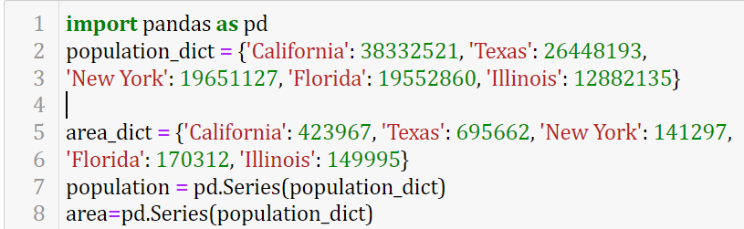


Slide 17
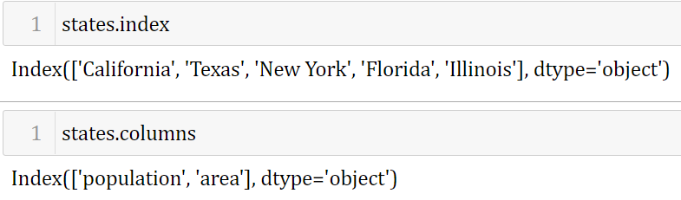

Slide 18
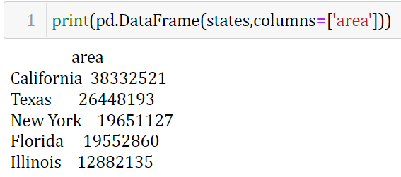

Slide 19
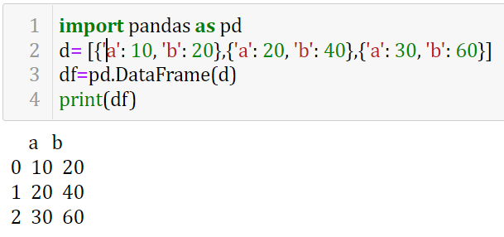
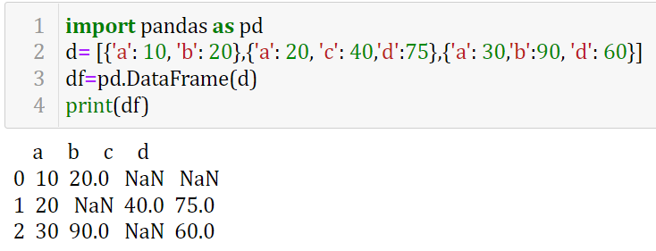
Any list of dictionaries can be made into a DataFrame

Slide 20
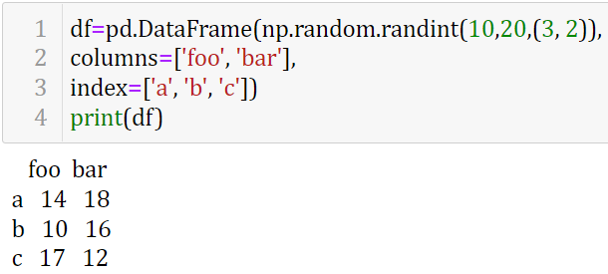
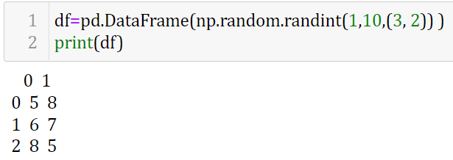
From a two-dimensional NumPy array
we can create a DataFrame with any specified column and index names.
If omitted, an integer index will be used for each

Slide 21
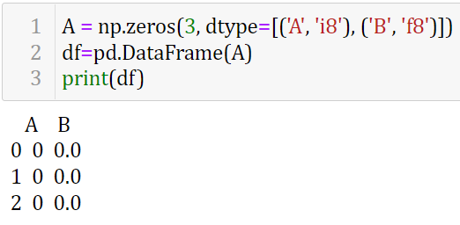
From a NumPy structured array
A Pandas DataFrame operates much like a structured array, and can be created directly from one

Slide 22
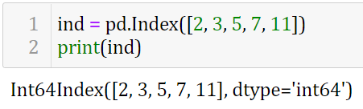
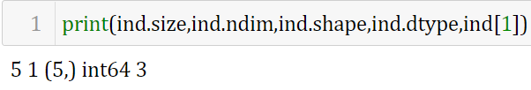
The Pandas Index Object
Both the Series and DataFrame objects contain an explicit index that lets you reference and modify data
Index object can be thought of either as an immutable array or as an ordered set
Index as immutable Array
To examine this, let’s construct an Index from a list of integers
Note: Difference between Index objects and NumPy arrays is that indices are immutable
The Index object in many ways operates like an array

Slide 23
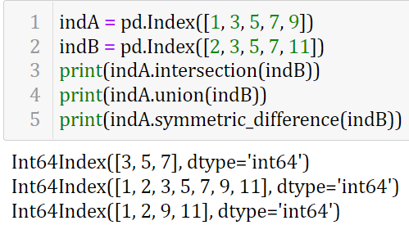
Index as ordered set
The Index object follows many of the conventions used by Python’s built-in set data structure, so that unions, intersections, differences, and other combinations can be computed in a familiar way.

Slide 24
Data Indexing and Selection
We’ll start with the simple case of the one-dimensional Series object, and then move on to the more complicated two-dimensional DataFrame object.
We are going to discuss:
Data selection in Series
Data Selection in DataFrames

Slide 25
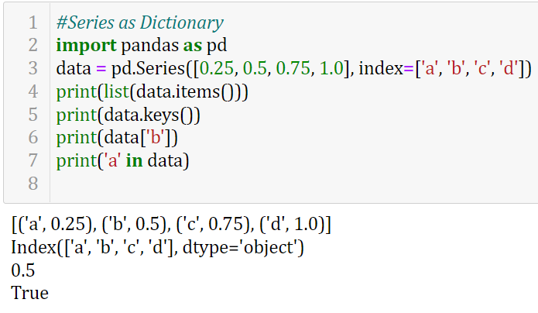
Data Selection in Series

Slide 26
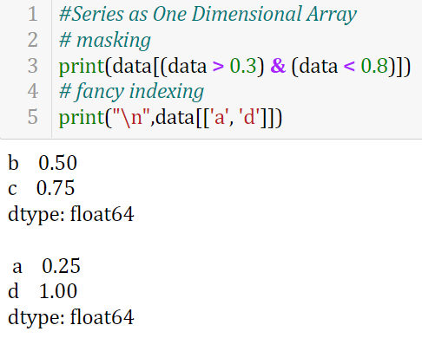
Data Selection in Series (Cond..)

Slide 27
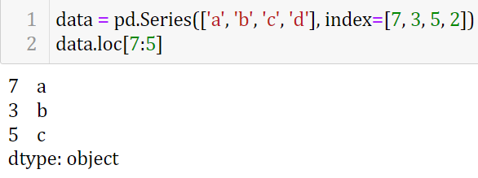
Indexers: loc, iloc
Because of this potential confusion in the case of integer indexes, Pandas provides some special indexer attributes that explicitly expose certain indexing schemes.
The loc attribute allows indexing and slicing that always references the explicit index

Slide 28
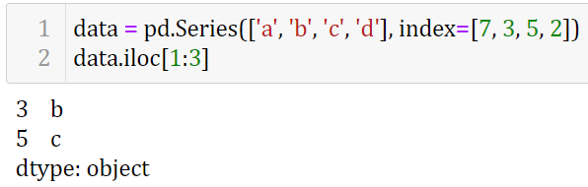
Indexers: loc, iloc (Cont.)
Because of this potential confusion in the case of integer indexes, Pandas provides some special indexer attributes that explicitly expose certain indexing schemes.
The iloc attribute allows indexing and slicing that always references the implicit Python-style index

Slide 29
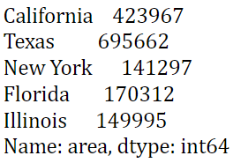
Data Selection in DataFrames
DataFrame acts in many ways like a two-dimensional or structured array, and in other ways like a dictionary of Series structures sharing the same index
As a dictionary
States.area
states['area']

Slide 30
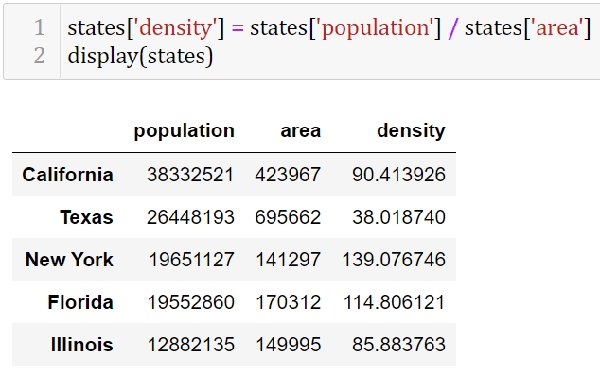
This dictionary-style syntax can also be used to modify the object, in this example added a new column

Slide 31
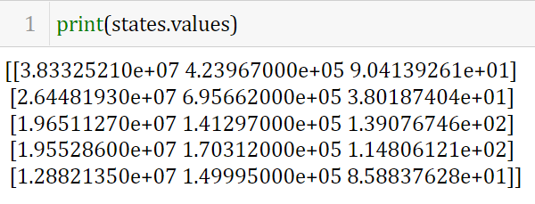
As a Two-Dimensional Array
we can also view the DataFrame as an enhanced 2D array

Slide 32
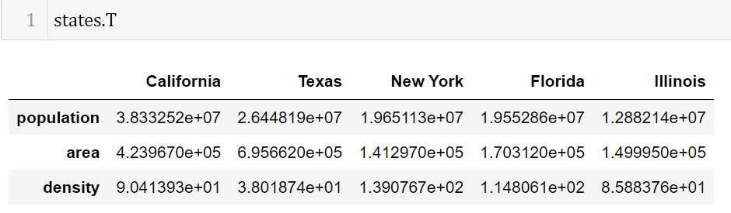
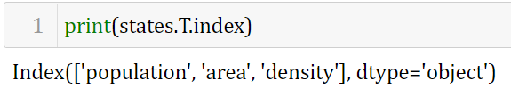
we can do many familiar array-like observations on the DataFrame itself.
For example, we can transpose the full DataFrame to swap rows and columns

Slide 33
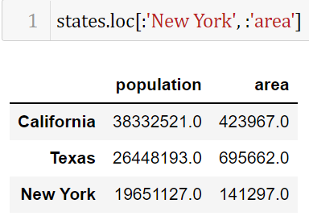
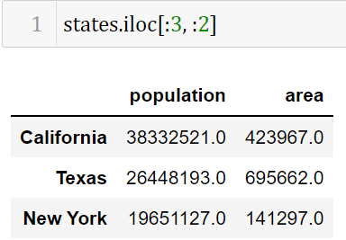
Indexers: loc, iloc
explicit index
implicit index

Slide 34
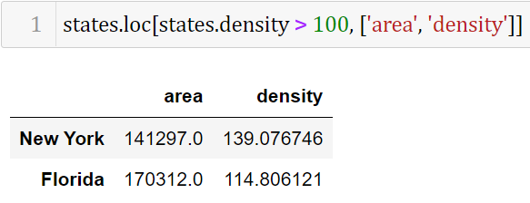
Any of the familiar NumPy-style data access patterns can be used within these indexers.
For example,
Using loc indexer we can combine masking and fancy indexing as shown here

Slide 35
Operating on Data in Pandas
For unary operations like negation and trigonometric functions, these ufuncs will preserve index and column labels in the output,
For binary operations such as addition and multiplication, Pandas will automatically align indices when passing the objects to the ufunc.
We will additionally see that there are well-defined operations between one-dimensional Series structures and two-dimensional DataFrame structures.

Slide 36
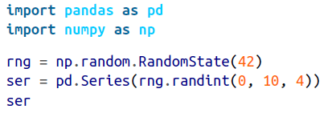

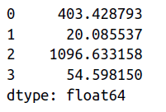
Ufuncs: Index Preservation

Slide 37
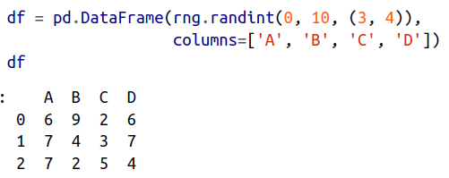
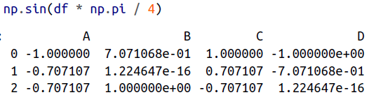

Slide 38
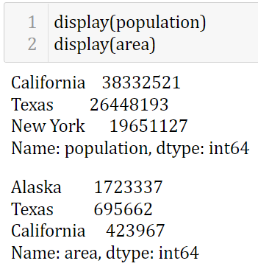
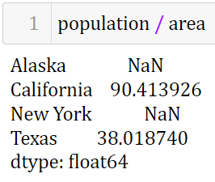
Ufuncs: Index Alignment
The resulting array contains the union of indices of the two input series

Slide 39
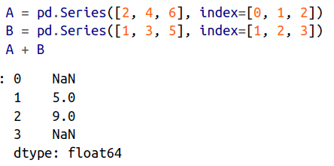
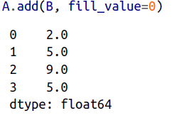
Index alignment in Series

Slide 40
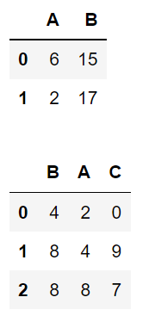
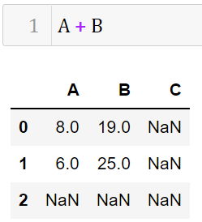
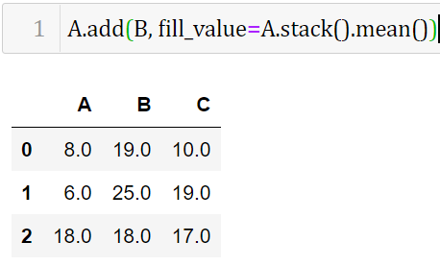
Index alignment in DataFrame

Slide 41


Slide 42


Ufuncs: Operations Between DataFrame and Series

Slide 43

Handling Missing Data
Because None is a Python object, it cannot be used in any arbitrary NumPy/Pandas array, but only in arrays with data type 'object' (i.e., arrays of Python objects)
The other missing data representation, NaN (acronym for Not a Number), is different;
it is a special floating-point value recognized by all systems that use the standard IEEE floating-point representation

Slide 44



Operating on Null Values
There are several useful methods for detecting, removing, and replacing null values in Pandas data structures
isnull(): Generate a Boolean mask indicating missing values
notnull(): Opposite of isnull()

Slide 45






Dropping null values
dropna(): Return a filtered version of the data

Slide 46


NaN and None in Pandas
Pandas handling of NAs by type

Slide 47




Filling null values
fillna(): Return a copy of the data with missing values filled or imputed

Slide 48


Filling null values
fillna(): Return a copy of the data with missing values filled or imputed

Slide 49

Hierarchical Indexing

Slide 50




Hierarchical Indexing
Hierarchical Indexing
Pandas MultiIndex
Pandas MultiIndex

Slide 51


Hierarchical Indexing
Hierarchical Indexing
Pandas MultiIndex as extra dimension
Pandas MultiIndex as extra dimension

Slide 52


Hierarchical Indexing
Pandas MultiIndex as extra dimension

Slide 53


Methods of MultiIndex Creation
pass a list of two or more index arrays
pass a dictionary with appropriate tuples as keys

Slide 54





Slide 55

MultiIndex level names

Slide 56

MultiIndex for columns

Slide 57


MultiIndex for columns

Slide 58

Rearranging Multi-Indices
Sorted indices
sort_index()
and
sortlevel()
Will be useful

Slide 59


Rearranging Multi-Indices
Index setting and resetting : To turn the index labels into columns,
this can be accomplished with the reset_index method.
resetting
setting

Slide 60
Combining Datasets: Concat and Append
pd.concat
pd.concat() can be used for a simple concatenation of Series or DataFrame objects
pd.concat( objs,
axis=0,
join='outer',
join_axes=None,
ignore_index=False,
keys=None,
levels=None,
names=None,
verify_integrity=False,
copy=True )

Slide 61






pd.concat
pd.concat() can be used for a simple concatenation of
Series or DataFrame objects

Slide 62



By default, the concatenation takes place row-wise within the DataFrame (i.e., axis=0)
pd.concat allows specification of an axis along which concatenation will take place

Slide 63


Duplicate indices
Catching the repeats as an error

Slide 64


Ignore index Duplicate

Slide 65

Concatenation with joins

Slide 66


